Slide 1
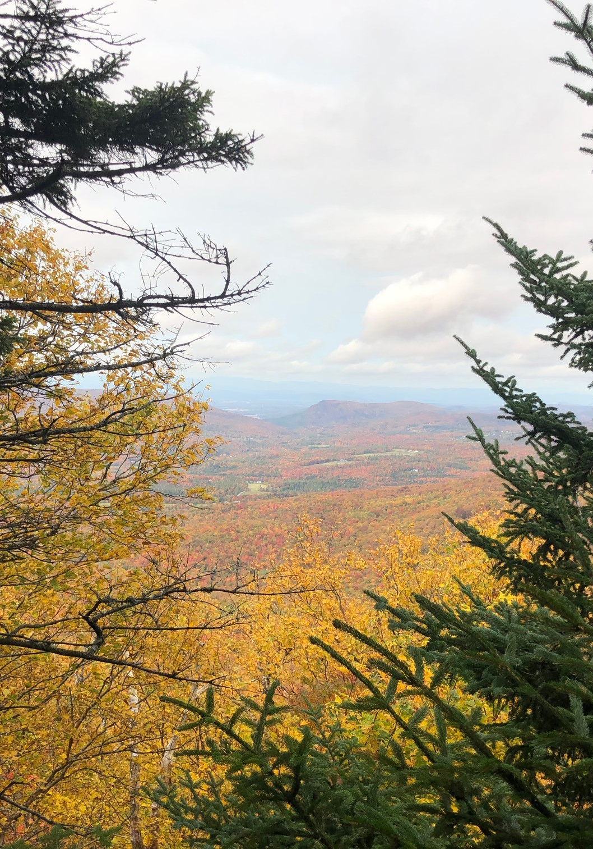
The Vermont Town Forests Census: Carbon,
COVID, and
Capacity
Julie Frost, MS Student, UVM RSENR
Cecilia Danks, PI, Associate Professor, UVM RSENR
September 5, 2024

Slide 2
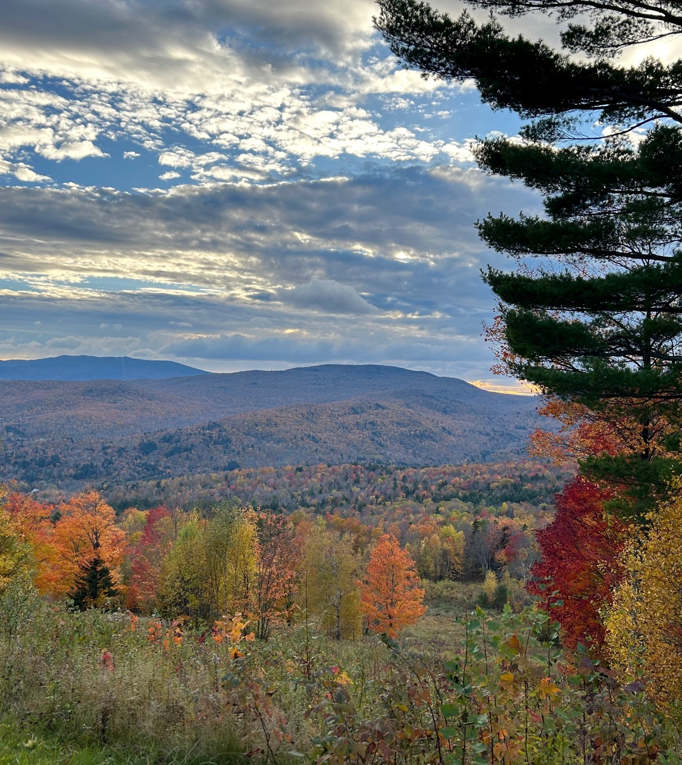
Purpose of VT Town Forest Census
Overarching goal:
To provide information to assist …
Agencies & universities (USFS, ANR, FPR, UCF, UVM)
Land trusts, non-profit organizations, and
Peer-learning efforts among towns themselves
In their efforts to build or expand
local capacity
sustainable management and inclusive governance
as stewardship models at the local level
What specific info or efforts will best support towns and their forests?

Slide 3
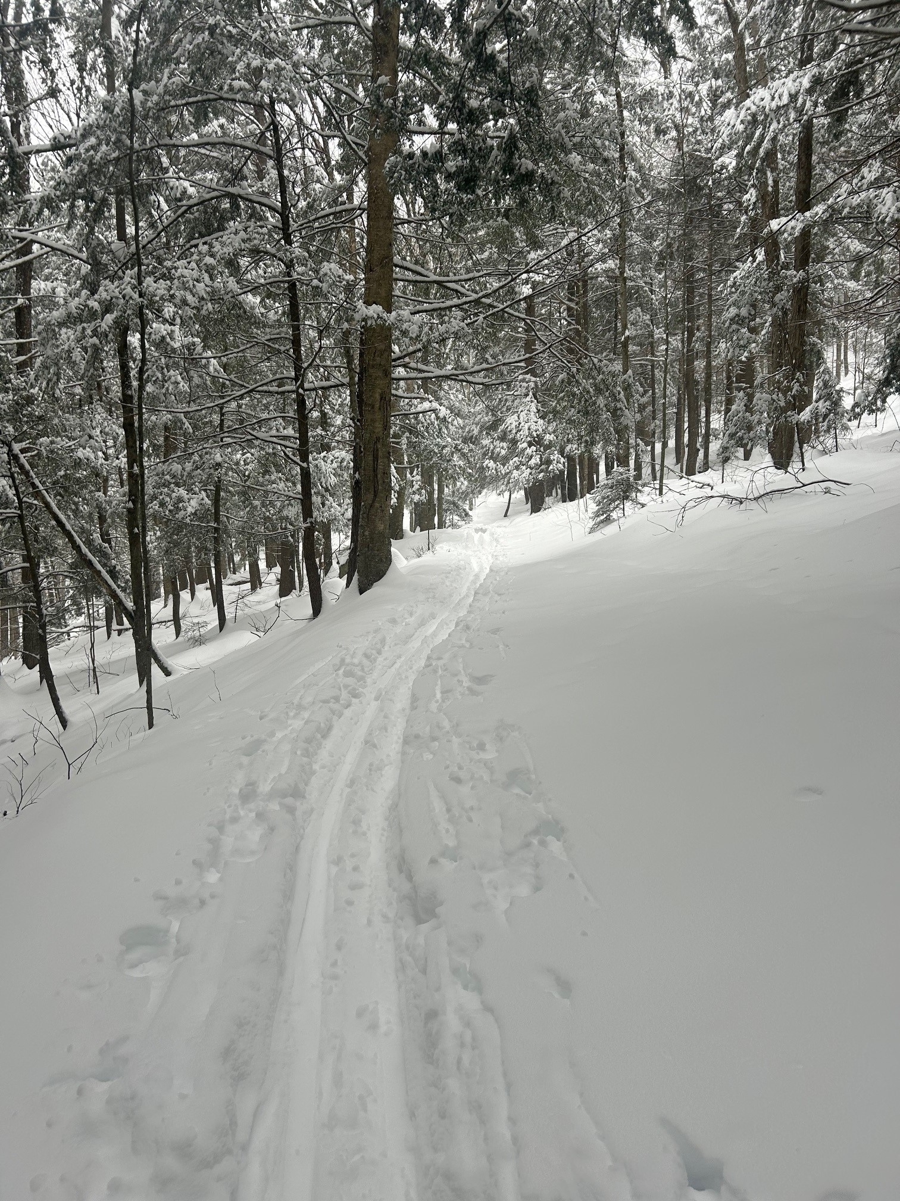
Specific Objectives and Deliverables
The census approach
Updated inventory and maps of ALL of Vermont’s town forests and their key contacts
Establish and conduct a replicable, statewide survey of ALL town forests
  Build a baseline of key information, goals, and challenges
  Inquire about specific, topical issues in each census cycle
  Monitor changes over time
Estimate economic impacts of town forests

Slide 4
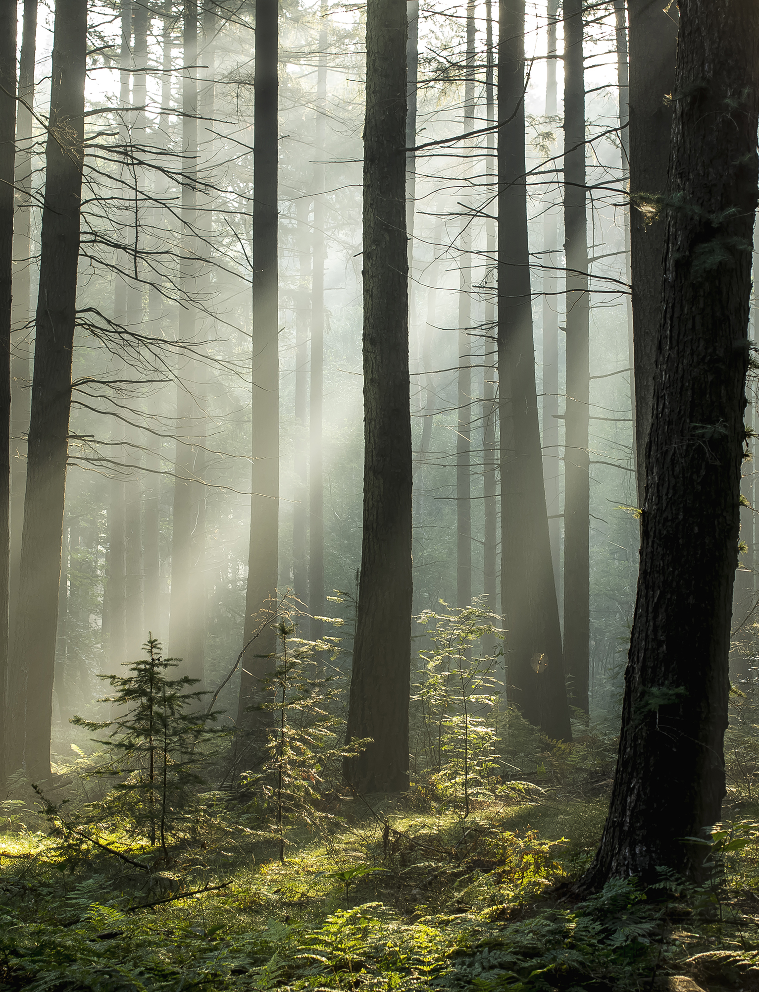
Survey Topics
Primary uses
Management plans
Conservation status
Challenges and issues
Resource needs (funding, technical)
Wood product harvests
Equity and Access
Indigenous aspects
Invasive Species
Carbon Market
Flooding
Pandemic Related Trends
Recreation

Slide 5
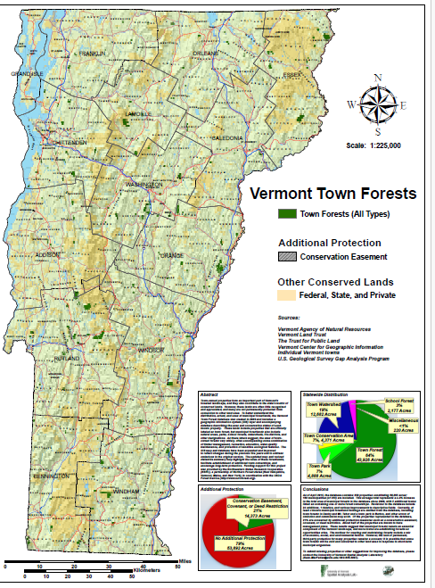
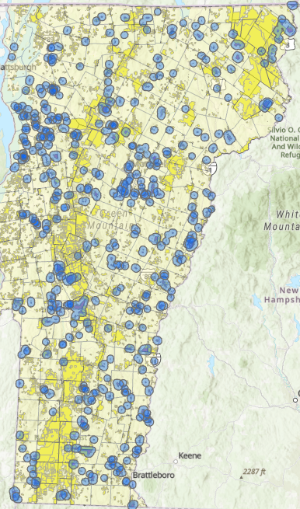
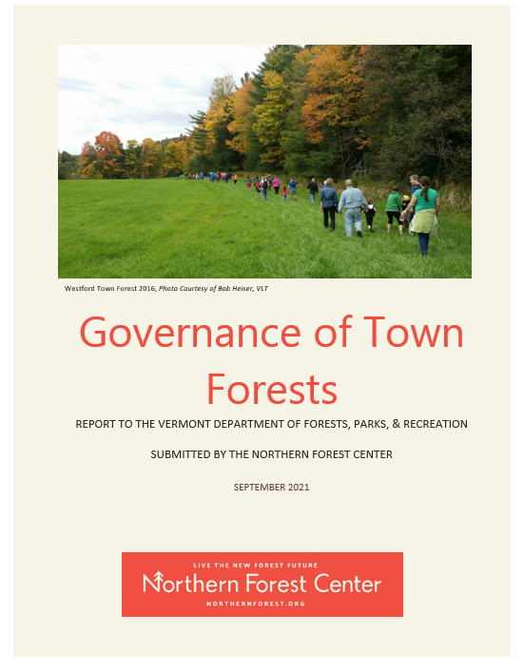
As of the 2015 inventory:
347 individual town owned forests
Includes parks and other partially forested town owned land
Totals ~68,000 acres
Currently embedded in the Protected Lands Database

Slide 6
Core Research Team
Cecilia Danks
UVM Associate Professor
Laura Edling
UVM Lecturer
Elise Schadler
VT FPR, Urban and Community Forestry
Keith Thompson
VT FPR, Private Lands Program
Julie Frost, UVM MS Student
Advisory Committee and Ad Hoc Advisors
Julie Evans – Northern Forest Center
Elissa Schuett – FEMC
Ali Kosiba – UVM Extension
Kim Coleman – UVM Associate Professor
Bob McCullough – UVM Historical Preservation
Andrea Shortsleeve – VT F&W
Chris Campany – ED Windham RPC
Melissa Levy – Community Roots
Rich Holschuh – Comm on Native American Affairs
Nick Bennett – ED VMBA, VTGC Chair
Claire Polfus – VT FPR Rec Program Manager
Bob Heiser – Vermont Land Trust Project Director
Kate Forrer – ED Vermont Woodlands Association
Tessa McGann – VT F&W Rutland Co Forester
Noel Dodge – VT FPR Biologist
Jens Hilke – VT F&W
Jared Ulmer – VT DOH Climate Health Program
Bill Jewell – UCF Council
Darren Schibler – Chittenden RPC
Sean MacFaden – UVM Spatial Analysis Lab

Slide 7
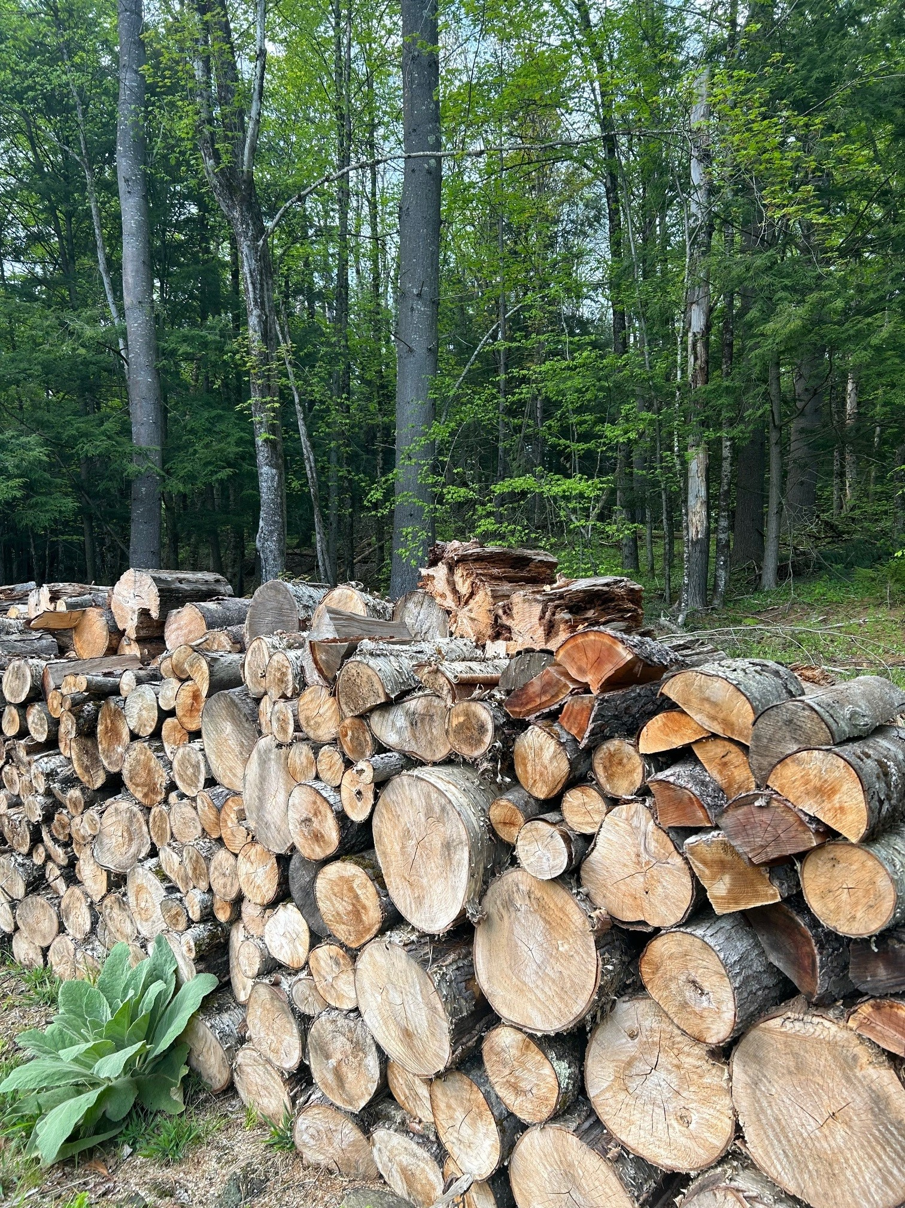
Our project deliverables
Baseline survey results and analysis
Public database and interactive map
Resources for towns
Economic report
Networks and connections
Enduring infrastructure for repeatability
Peer reviewed journal articles

Slide 8
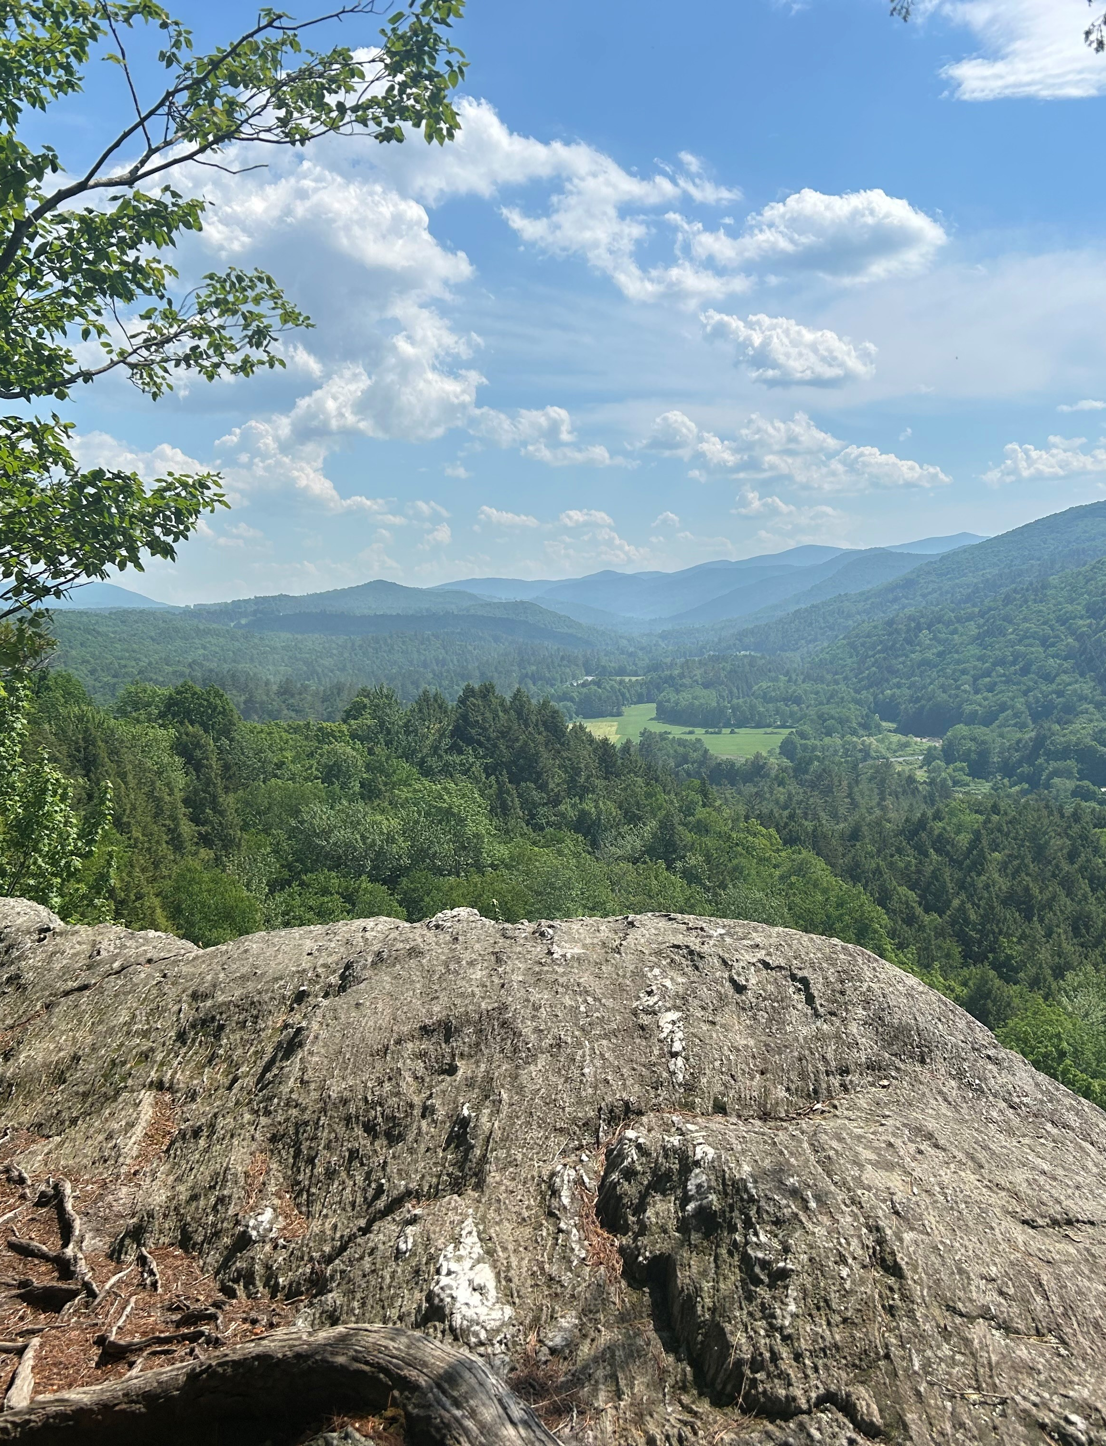
Project Status, Next Steps and Challenges – we need your help!
Pilot testing of census complete!
Initial Town Outreach in progress
  Updating inventory of town forests
  Determine best point of contact
Socializing and networking
  Increase awareness
  Improve data collection
  Facilitate peer learning
Launch census this month!

Slide 9
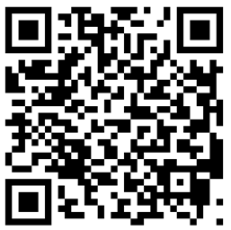
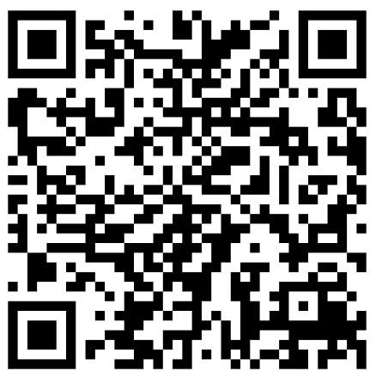
thank you!
Project website https://site.uvm.edu/vermonttownforestcensus/
Email us!
vermonttownforestproject@uvm.edu
“The land teaches us how to live in harmony with all beings.”
-Robin Wall Kimmerer
Urban and Community Forestry Program
New Town Forest Stewardship Toolkit!
https://vtcommunityforestry.org/projects/town-forests
Julie Frost
  Julie.frost@uvm.edu
Acknowledgements:
Sean McFaden, UVM Spatial Analysis Lab
Julie Evans, Northern Forest Center

