Slide 1
Town Lands Management Plan
Krista Karlson
Thetford Conservation Commission (TCC)
September 5, 2024
conservation@thetfordvt.gov

Slide 2
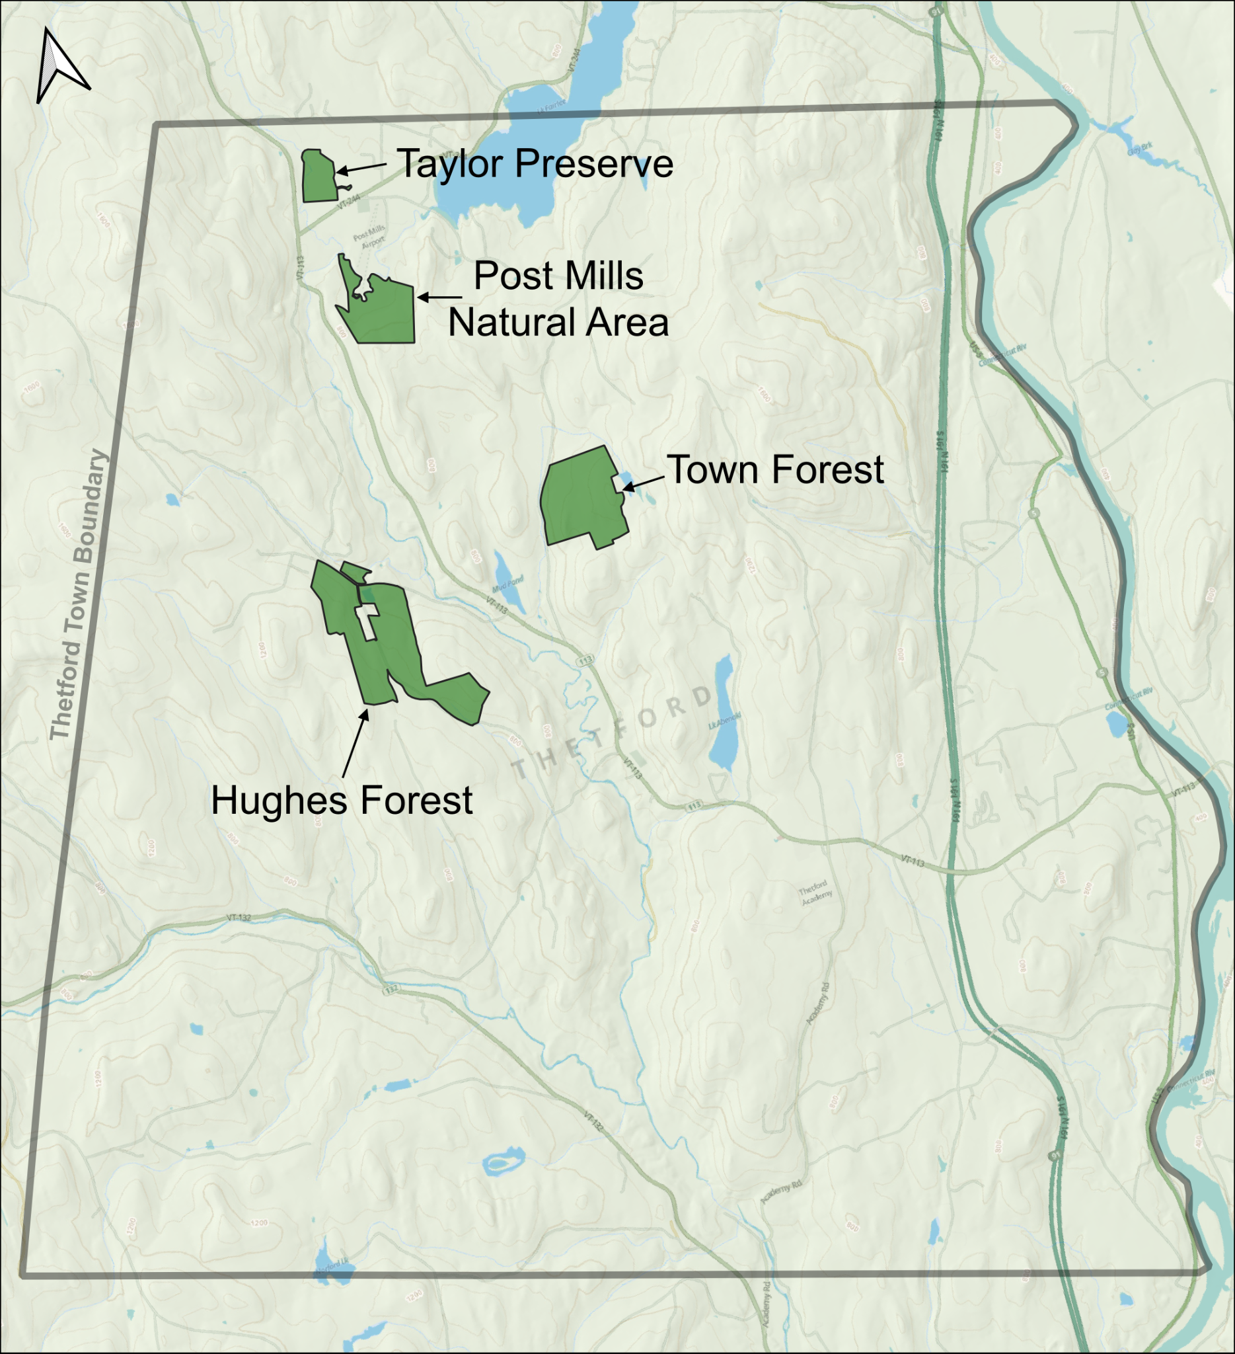
Town-Owned Parcels
Approximately 560 acres
All have conservation easements
Contain forests, shrublands, grasslands, and riparian habitats.
Conservation Commission tasked with stewarding land. Each member is assigned to a parcel.
“Conservation means the greatest good to the greatest number for the longest time.”
- Gifford Pinchot, The Fight For Conservation

Slide 3
Why This Plan?
Plan is meant to be updated every 10-15 years
Take stock of each property
Allows management to adapt to changing threats and challenges
Resilience
Observe and Analyze
Property
Develop Plan
Define and Prioritize Goals
Long-term carbon storage
Notes:
Overarching goals of the plan:
Resilience (to new diseases, droughts, floods, temperature changes, and everything else climate change will bring)
Long-term carbon storage (by increasing forest diversity to increase sequestration and ultimately achieve more old-growth-like conditions)
Observe and Analyze Property
Gives us an idea of the current state of the property, how well previous management actions are working, and if there are any acute threats to ecosystem health that need to be considred.
Define and Prioritize Goals
What do we want these parcels to look like?
Given our limited resources, what is the most important thing to focus on to help move the parcel towards our vision?
Develop Plan
What is the best way to help move from the current state to our ideal future?

Slide 4
Timeline
Review existing guidance: Prior Mgmt Plan, Town Plan, Natural Resources Inventory, etc.
Orange County Forester conducts inventory and drafts initial management plan
Host public walks, conduct a public interest survey, and host public comment meeting
Identify volunteer activities, recruit volunteers, host work days, create detailed appendices
Spring 2023
2023
Winter/Spring 2024
2024-
Summer/Fall 2023
Winter 2024
Spring 2024
Identify high-level themes and objectives
Commission considers recommendations and refines draft plan
Final draft of Town Lands Mgmt Plan, create timeline of management activities
Notes:
Take stock of all the existing guidance so we had a solid foundation
Collect field data
Refine the recommendations for each property. NOTE: This was the most time-consuming. We spent about 6 months on this phase! It was important to have a lot of deep conversations around how to achieve our goals, what was reasonable given our limited resources, and what we thought would best serve the Thetford public.
There was one property that was the most difficult to navigate because our recommendations involved tree cutting for long-term resilience which some neighbors were not happy about. This forced us to go through a thoughtful, slow process of engagement and to be really solid in our reasoning for making those recommendations.
Really excited about the final draft! The goal is for the plan to have staying power. We will create appendices with specific mowing plans and logging plans.

Slide 5
Implementation with Volunteers
Recruitment
Program Setup
Paper and online survey to collect public input on the Town Lands Management Plan (70 responses)
Growing our email list
New social media accounts
Developed a liability waiver
Developed volunteer “job descriptions”
One TCC member will be the point person for volunteer recruitment
Parcel-specific TCC members will run volunteer sessions
AVCC funds to purchase supplies

Slide 6
Questions?
Read the full plan here!
conservation@thetfordvt.gov

